Slide 1
Introducing Post From The Past
English I
Notes:
This presentation demonstrates the new capabilities of PowerPoint and it is best viewed in Slide Show. These slides are designed to give you great ideas for the presentations you’ll create in PowerPoint 2010!
For more sample templates, click the File tab, and then on the New tab, click Sample Templates.

Slide 2
Expectations
1
2
3
4
I will be an a active participant in class
I will respect other students, teachers, and myself.
I will push myself to expand my perspectives and horizons
I will come prepared to class
The Class Rules

Slide 3
Signing in to class:
Last name then first name
Saving Assignments
Last name, first name, assignment name
I should have access to your English folder in your Google Drive.
If you have not done that, you need to do that TODAY
Announcements

Slide 4
Writers will create engaging narratives to share a personal experience or perspective of the world
Learning Targets

Slide 5
15 Minute Timed Writing
Writing:

Slide 6
Timed Writing Prompt & Procedures
Open A New Blank Word Document
Put your Name at the top
Put The Tittle: Timed Writing 1 next
Put The Date (September 11, 2013) last
Save to your Google Drive in your SHARED English Folder as “Timed Writing 1”
You have 15 Minutes to Free Write on the Prompt below

Slide 7
Harry Potter Series Bloomsbury Edition
The Absolutely True Diary of a Part-Time Indian
The Not-So-Star-Spangled Life of Sunita Sen
The Perks of Being a Wallflower
The Hunger Games Series
Beowulf (Heaney translation)
Riverside Shakespeare
Fahrenheit 451
Pretty Little Liars
Twilight Series
The Shining
Pyongyang
Maus I & II
Divergent
Chopsticks
Columbine
Insurgent
Allegiant
Persepolis
Flawless
Matched

Slide 8
Brain Break

Slide 9
Post From the Past Due Monday, September 16th
Learning Target: Writers will create engaging narratives to share a personal experience or perspective of the world
Narrative Writing Assessment 1

Slide 10
Post From The Past
This first project is a presentation that describes you, your family and anything you want to tell about yourself through a narrative. Your grade will be based upon the 9P: Experience/Event Narrative Writing Scale. Your project will be two parts.
Learning Target: Writers will create engaging narratives to share a personal experience or perspective of the world

Slide 11
Post From The Past
The first part is the written portion; in this you will share your experience of being a teenager in 2013 with the future by writing a letter to the future you in 2043. You should include details about how you spend your time each day, hobbies, television shows or movies you like, music that you listen to, the books or blogs you like to read, the video games you like to play, and anything else that you think will help the future you to remember what it was like to be you in 2013.
Learning Target: Writers will create engaging narratives to share a personal experience or perspective of the world

Slide 12
Post From The Past
The second part of this project will be a visual aid in which you will create a collage or visual time capsule of the details you include in your narrative. You should include a photo of yourself as well, so that the future you can reminisce. To create your collage you may use any one of the following tools, Glogster.com, ThinkLink.com, Prezi.com or PowerPoint.
Learning Target: Writers will create engaging narratives to share a personal experience or perspective of the world

Slide 13
Scale 9: Experience/Event Narrative Writing
q I can write clear and coherent narratives to develop stories that retell real or imagined experiences or events that clearly address the writing prompt or purpose and audience.
q I can use well-chosen details and structure events to follow a clear plot structure or follow clear organizational structure.
q I can use a tone that is appropriate to the writing prompt.
q I can write a clear introduction, body and conclusion. I can follow the conventions of spelling, grammar, sentence and paragraph structure.
q I can write to engage and orient the reader by setting out a problem, situation or observation; establish point of view, use narrative techniques such as dialogue, pacing, description, telling details and sensory language, or multiple plot lines, to convey experiences and develop complex characters.

Slide 14
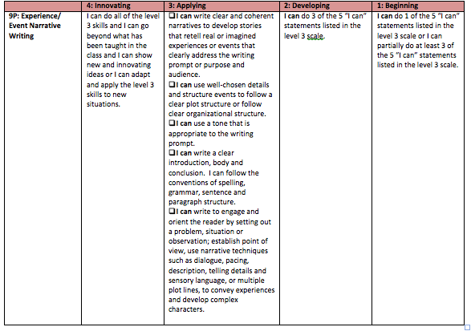
Scale 9: Experience/Event Narrative Writing

Slide 15
Questions?
Learning Target: Writers will create engaging narratives to share a personal experience or perspective of the world

